Slide 1

2013
Tabular Transport ation Collision Data Analysis
Made by:
Yueming Zhou
Zhicheng Zhu

Slide 2

Injury collision is more likely to happen in which location under what situation?

Slide 3

Data Collection
Get to know about the raw data

Slide 4



Brife introduction
2013 Tabular Transportation Collision Data Records collisions happened in 2013 . 15,156 collisions in total
16 attributes about all details of a collision
Resource
Open Ottawa
Dataset provided by the City of Ottawa
Link
https://open .ottawa .ca/datasets/ottawa::2013-tabular-transportation-collision- data/about

Slide 5



COLLISION_ID
A unique file id of the
collision
COLLISION_CLAS SIFICATION
Fatal injury, non-fatal injury, and P . D only (property damage only) .
LONGITUDE
Longitude of the collision location
LATITUDE
Latitude of the collision location
DATE
Date when the collision happened
ENVIRONMENT
The weather condition when the collision happened . Includes: Unknown, Clear, Rain, Snow, Freezing Rain, Drifting Snow, Strong wind, and Fog/mist/smoke/dust .
TRAFFIC_CONTR
OL
Traffic control type: Traffic signal, stop sign, yield sign, school bus, traffic gate, traffic controller, no control, and roundabout
TIME
Specific time when the collision happeded
X
X coordinator projected in MTM Zone 9, NAD83(CSRS)
Y
Y coordinator projected in MTM Zone 9, NAD83(CSRS)
LIGHT
The light condition when the collision happened . Includes: unknown, daylight, dawn, dusk, and dark .
LOCATION
Street names of the location where the collision happened .
In forms of RD1 @ RD2 or
RD from RD 1 to RD 2
NO_OF_PEDESTR
IANS
Number of pedestrians involved in the collision
TRAFFIC_CONTR
OL_CONDITION
unknown, functioning, not functioning, and obscured .
SURFACE_CONDITION
The surface condition includes: unknown, dry, wet, loose snow, slush, packed snow, ice, mud, loose sand or gravel, spilled liquid, and other .
IMPACT_TYPE
Impact type includes: approaching, angle, rear end, sideswipe, turning movement, SMV unattended vehicle, SMV other, and other type .

Slide 6
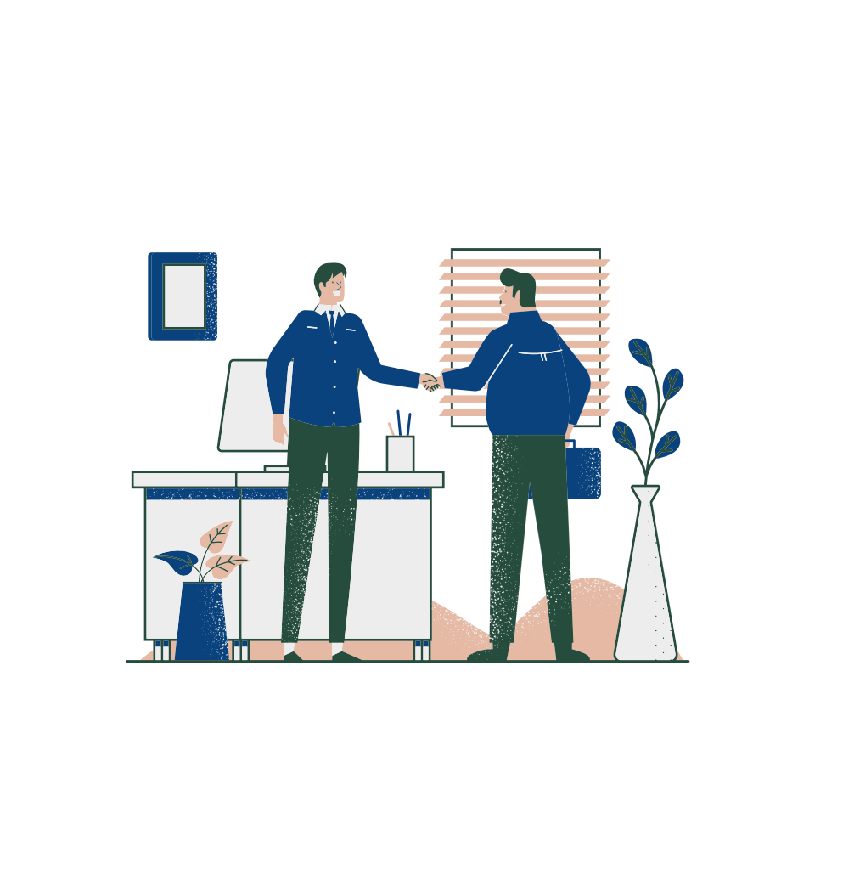
Data Preprocessing
process raw data step by step

Slide 7






A
Step 1
Step 2 Step 3 Step 4 Step 5 Step 6
Delete irrelevant attributes: COLLISION _ ID,
NO _OF _ PEDESTRIANS,TRAFFIC _CONTROL _CONDITION, LONGITUDE, and LATITUDE
Modify attribute Date, Time, Location, and collision _classification
Load the file to Weka, convert all the attributes to the right data type
Apply filters removeDuplicates
according to X and Y, divided the collision location into 5 zones
Add new attribute Location and remove attributes X,Y
A
A
R
R
R

Slide 8
Date
Modify it to represent date group
Weekdays
Weekend
Early_Morning Morning Noon Afternoon Evening
Night
Mid_night
Highway
Road
Time
Modify it to represent time group
LOCATION
Create a new attribute Road_type to represent different type of road
COLLISION_CLASSIFICATION
Modify the classification
Injury P.D only

Slide 9

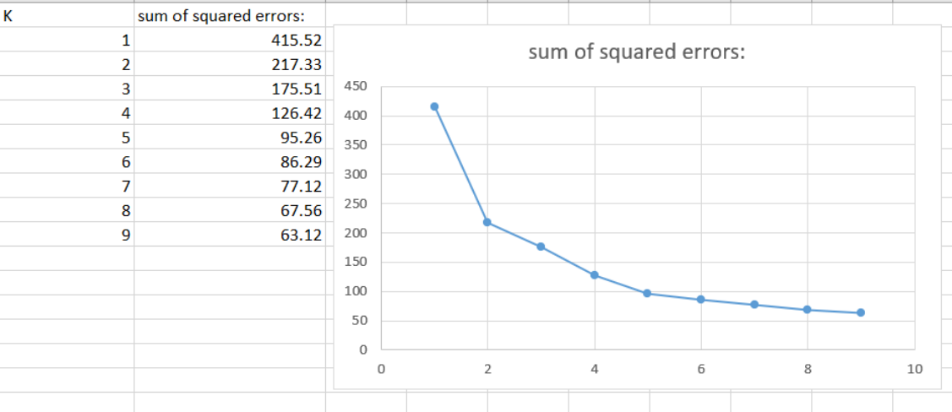
, Y -- > Location
using clustering
create a new csv file records x, y and collision _classification
find the best k for kmeans
perform clustering
X

Slide 10

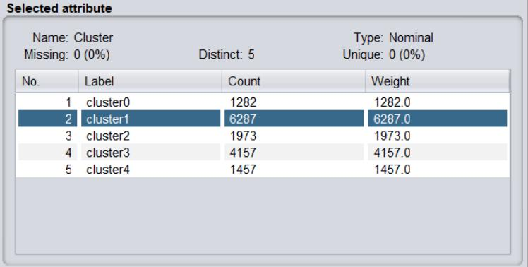
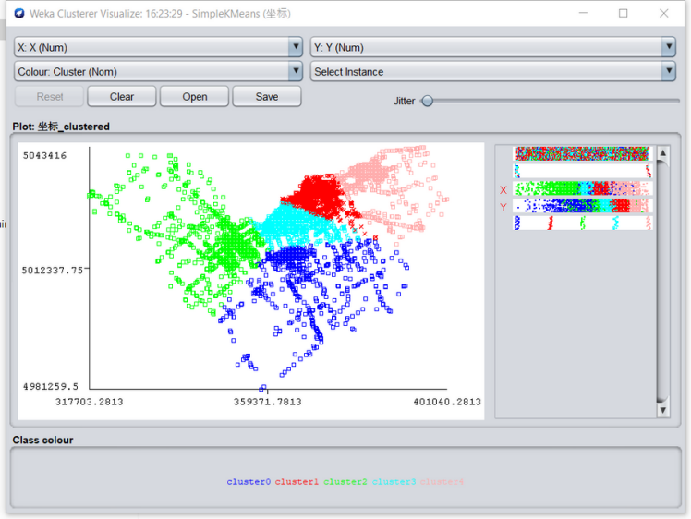
X Y -- > Location
using clustering
create a new csv file records x, y and collision _classification
find the best k for kmeans
perform clustering
,

Slide 11





Road_type
nominal
Road: 13022
highway: 2134
LIGHT
07- Dark: 3368
01- Daylight: 10622
05- Dusk: 682
03- Dawn: 353
00-Unknown: 131
DATE
nominal Weeday: 11974 Weenkends: 3182
SURFACE_CONDI
TION
nominal
01- Dry: 9500
06- Ice: 692
02-Wet: 2850
04-Slush: 458
03- Loose snow: 1168
05- Packed snow: 416
00-Unknown: 35
99-Other: 14
08- Loose sand or gravel: 18
07- Mud: 3
09-Spilled liquid: 2
IMPACT_TYPE
nominal
02-Angle: 2058
01-Approaching: 215
06-SMV unattended vehicle: 1141 03- Rear end: 5101
07-SMV other: 2761
04-Slideswipe: 1821
05-Turning movement: 1693 99-Other:
ENVIRONMENT
nominal
01-Clear: 11588
02- Rain:1420
03-Snow: 1798 04- Freezing Rain: 145 05- Drifting Snow: 86 06-Strong wind: 26 07- Fog,mist .smoke,dust: 50 00-Unknown: 43
TRAFFIC_CONTR OL
nominal
10- No control: 7904 02-Stop sign: 1477 01-Traffic signal: 5579 03-Yield sign: 160 07-School bus:2 09-Traffic controller: 9 11- Roundabout: 6 08-Traffic gate:13 Unknown: 6
TIME
nominal night:4864 Evening: 3704 Mid _ Night: 2409 Early _ Morning: 375 Afternoon:1537 Morning:201 Noon: 2066
LOCATION
nominal downtown:1973 mid-town:1282 Ottawa _south: 6287 Ottawa _west: 1457 Ottawa _east: 4157
COLLISION_CLAS
SIFICATION
nominal
Injury: 2795
P . D . only: 12361

Slide 12

Expectation
We assume that injury collision is more likely to happen in downtown at rush hour under bad weather.

Slide 13

ANALYSIS & Result
Using decision tree, Knn, Clustering and Association Rule

Slide 14

Decsion Tree
Decision tree classifiers are one of the most popular and used classification
techniques because the tree is constructed from the given data based on simple equations and uses the attribute selection measures such as a gain ratio measure, which ranks the attributes and determines the most useful attribute, and accordingly the researcher can realize the most efficient attributes on the predicted purpose

Slide 15
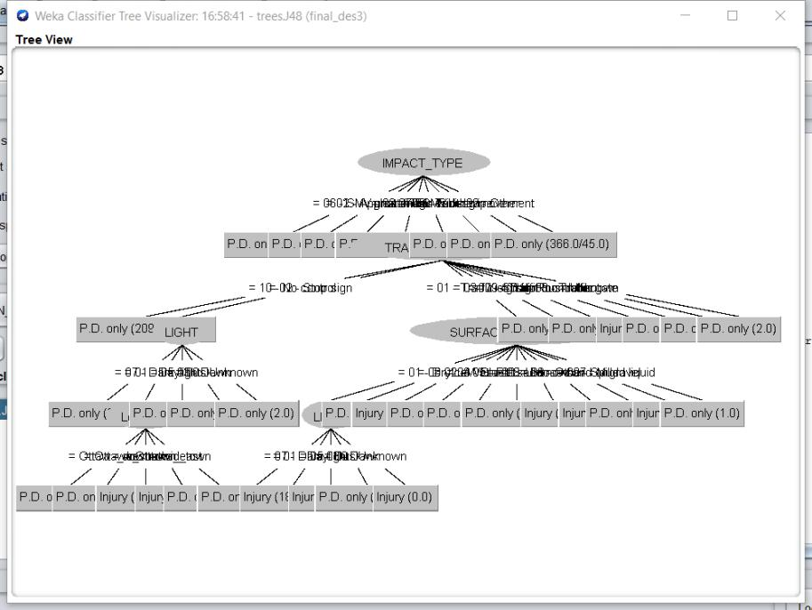
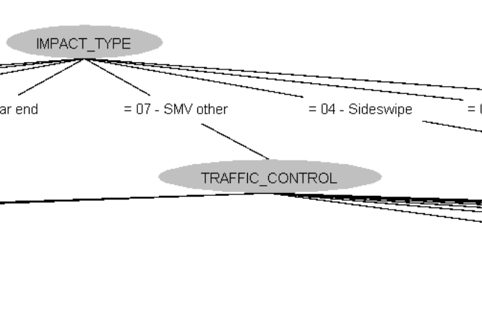

Decsion Tree
Here is the J48 Decision Tree that we got from the datasets, and there is Visualization graph. From the graph we can see the most relative attribute with Collision Classification is Impact type And the secondly related to it is Traffic control.

Slide 16


kNN （k-Nearest Neighbors）
Knn is one of the easiest classification algorithms . It is a method for
classifying objects based on the closest exemplary instances in the attribute vector space .

Slide 17
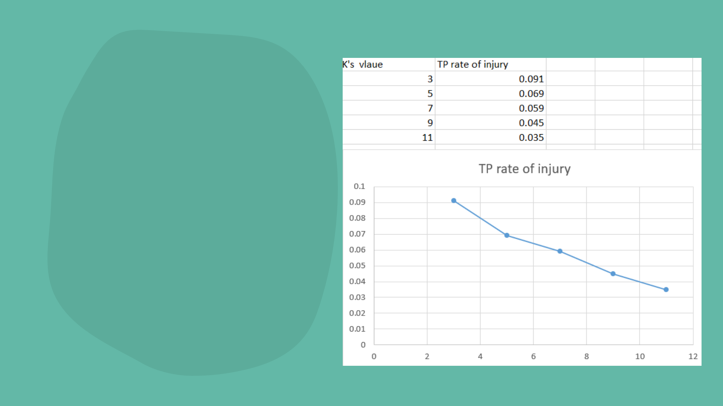
KNN
We set the cross-validation to 10 folds to find
the knn classification . from the graph we could see the highest TP value is when k = 3 . So we decide to using the predict result when k queals to 3 .

Slide 18

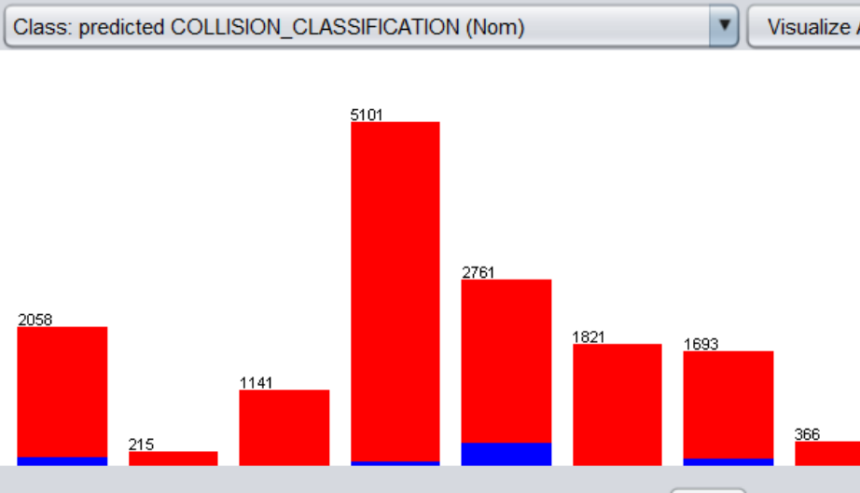
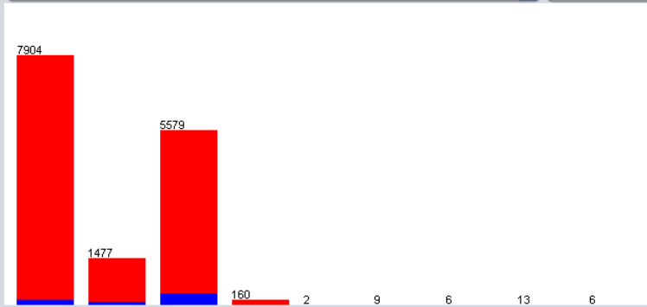
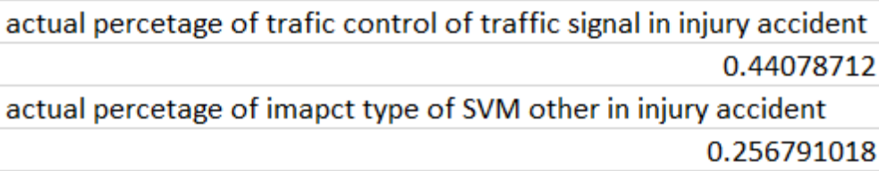
KNN
Here is some of the about knn = 3 . We can
prediction result
found that
The graph shows that the highest possibility of impact type to
have injury traffic collision is the fifth column which is SVM - other . the prediction percentage is 344/677 which is 58 .1%
The graph shows that the highest possibility of traffic control to
have an injury traffic collision is the third column which is traffic signal . The prediction percentage is 383/677 which is 56 .6%

Slide 19
Clustering
Clustering is an unsupervised machine learning task . It involves automatically
discovering natural grouping in data . Unlike supervised learning, clustering algorithms only interpret the input data and find natural groups or clusters in feature space .

Slide 20
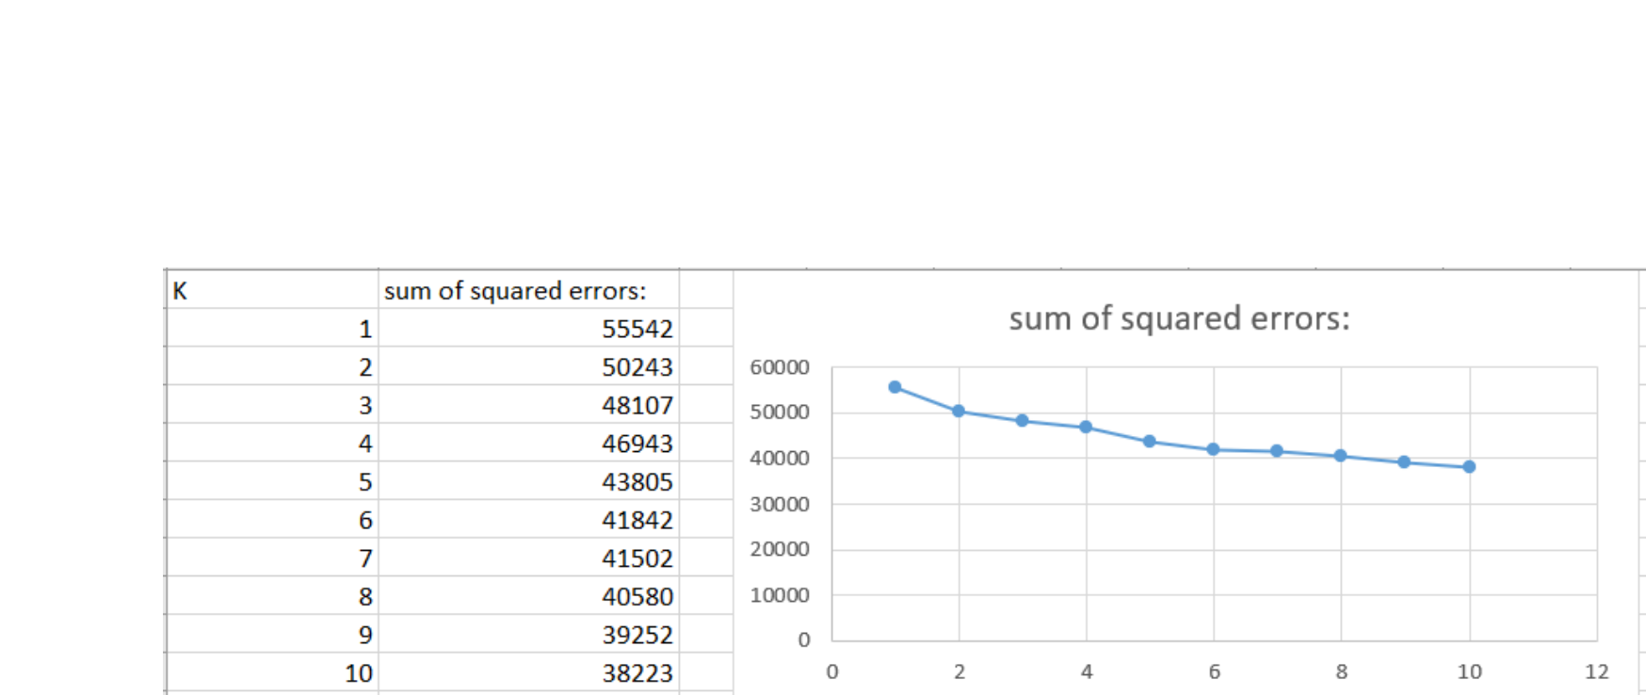
Clustering
We are going to use k_means clustering during the clustering process. The first step is choosing a appropriate k value
We test the k value from the 1-10 and here is result of the sum of squared the errors. From the graph we could see that when k = 6 the graph line goes stable. So we choose k = 6 to do the next step.

Slide 21
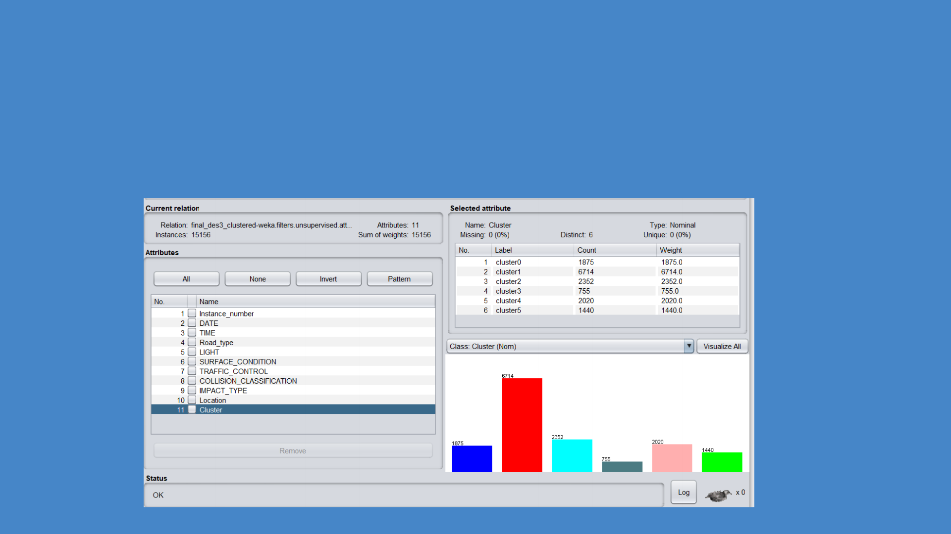

Clustering
Here is the result of the data after clustering

Slide 22
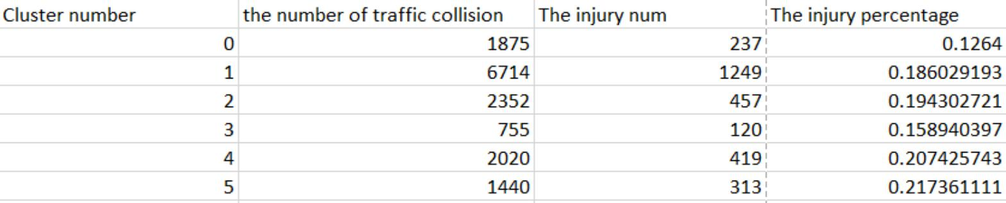
Clustering
after clustering process, we check the data conclude in each cluster.
we found that cluster 5 has the highest injury percentage.

Slide 23

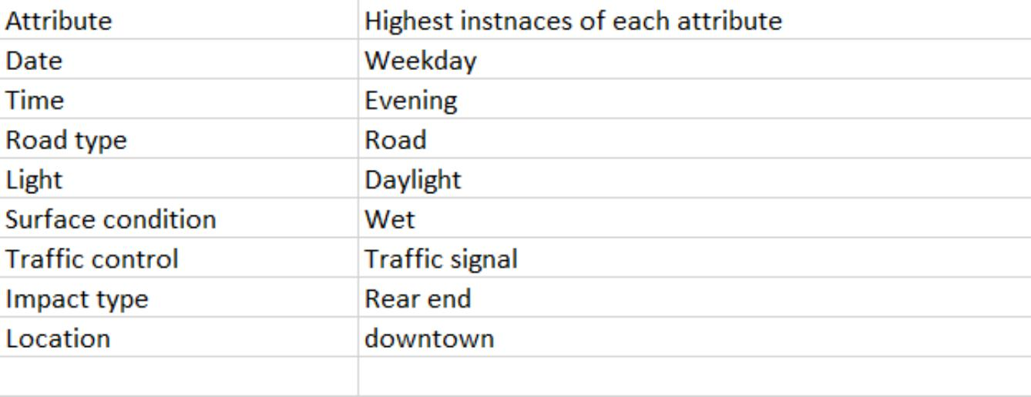
Clustering
In the higheset percetage to happens injury traffic collision, we found the
result like this.

Slide 24

Association Rule
Association rule mining finds interesting associations and relationships among
large sets of data items . This rule shows how frequently a itemset occurs in a transaction .

Slide 25

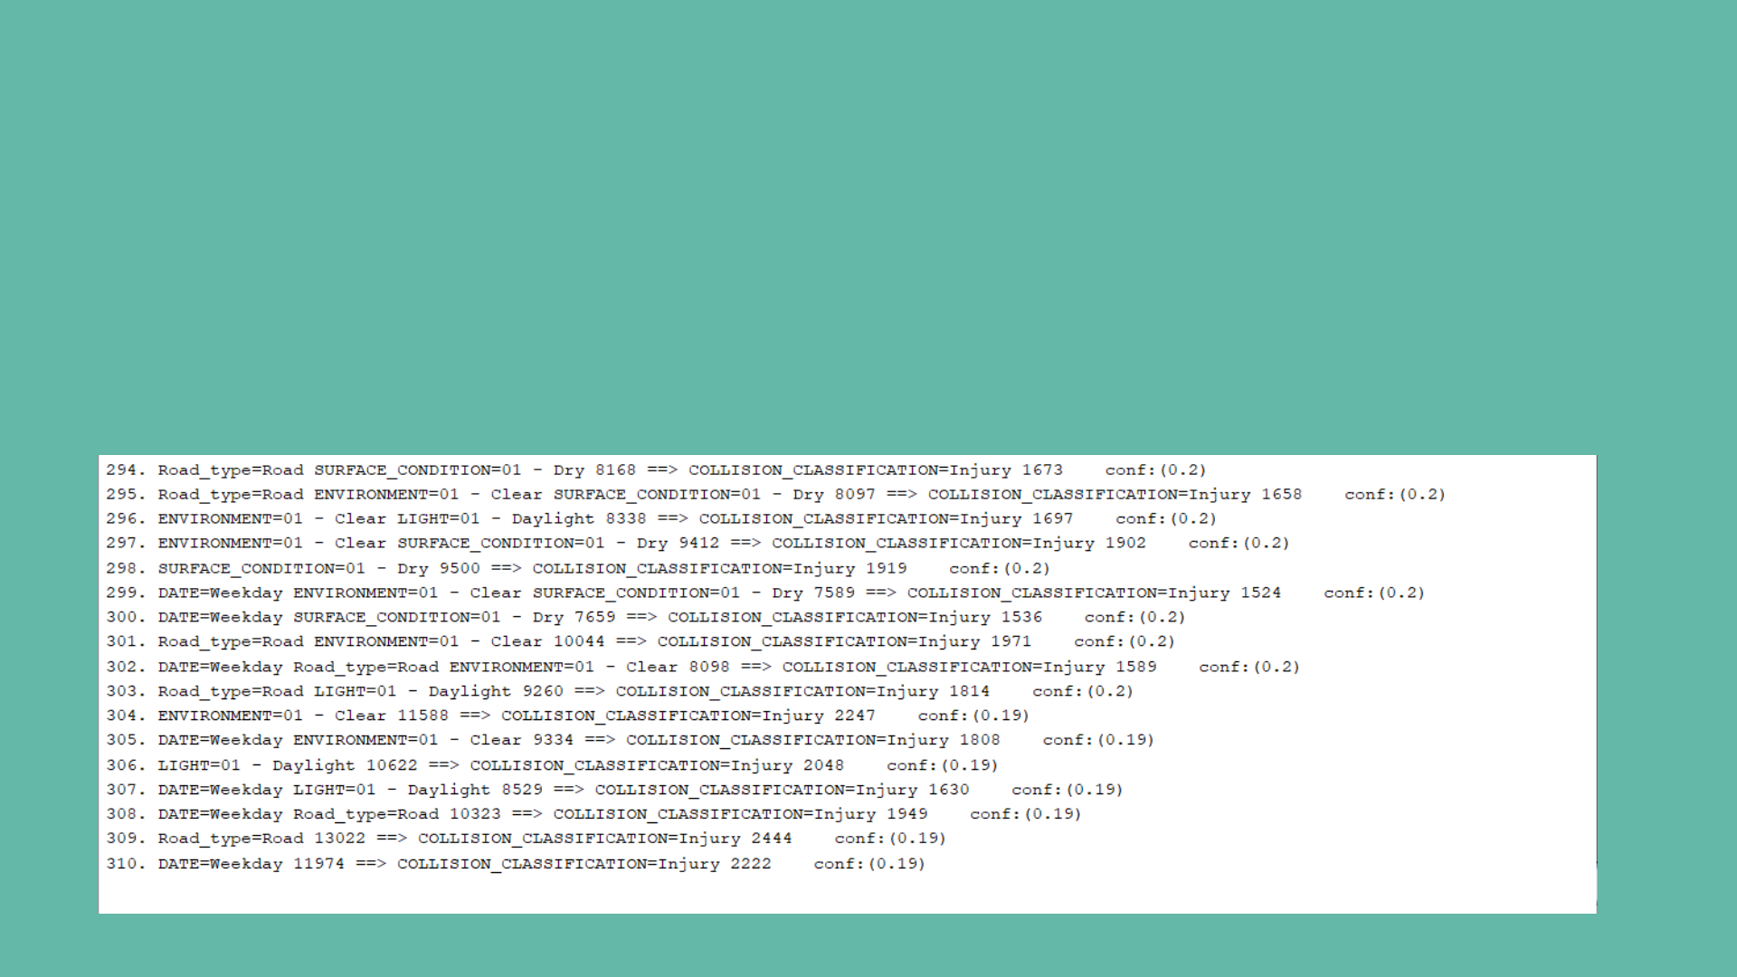
Association Rule
which conditions
the apriori algorithm to run the Association process. result we have.
Injury happened in
We are using Here is the

Slide 26

Association Rule
Injury happened in which conditions
Road, dry surface
Road, clear environment, dry surface Clear environment, daylight
Clear environment, dry surface Dry surface
Weekday, dry surface
Road, clear environment
Weekday, road, clear environment
Road, daylight

Slide 27

Conclusion
what we learn from the analysis what can we do in the future

Slide 28
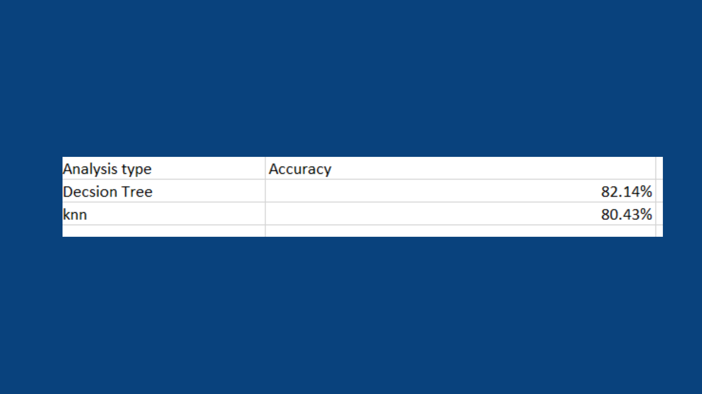
analysis method accuracy
We get the accuracy from the correctly classification rate .

Slide 29
Decision Tree
the most relevant attribute is impact type
The prediction result is getting a bit higher than the actual
result. However, the accuracy of the overall result is high. We can
_{kNN} find that most of the correct classified instances is
P.D.property instead of injury. Our conclusion is, even though the KNN provides a high accuracy but the disadvantage is it does not always make sense for each attribute.
Clustering injury collision is more likely to happen in weekdays, in downtown.
The result is out of our expectations, the injury type always
appeared with the mild weather and environmental condition .
Association Rule

Slide 30
Conclusion
Under all of analysis result, our prediction is that injury collision is more likely to happen in downtown at weekdays under mild weather and environment condition, and also, the most like to effect the injury collision is impact type of SMV -other and the traffic control of traffic signal.
For further effect of society, it could be suggestion for government to make sure traffic signal work well all the time and also a suggestion for driver to be more careful to drive under these kind of situation.

Slide 31



















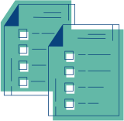

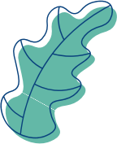
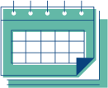


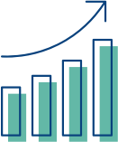




Question?

